Slide 1
Blockchain Consensus

Slide 2
Nakamoto Consensus
The Nakamoto Consensus gave birth to blockchain as we know it
what makes it so different from consensus mechanisms that came before it?

Slide 3
Nakamoto Consensus
The Nakamoto Consensus, as its name implies, was created by Satoshi Nakamoto, Bitcoin’s pseudonymous founder, in the Bitcoin white paper.

Slide 4
Nakamoto Consensus
It can be considered the solution to the Byzantine Generals Problem, a thought experiment that deals with a key question in computer science.
Is it possible to form a consensus in a computer network of independent, distributed nodes? — The Nakamoto Consensus says that yes, indeed it is.

Slide 5
Nakamoto Consensus
The Nakamoto Consensus is a set of rules that verifies the authenticity of a blockchain network, using a combination of the proof-of-work consensus algorithm on a Byzantine Fault Tolerance (BFT) peer-to-peer network.

Slide 6
Byzantine Fault Tolerance(BFT)
Byzantine Fault Tolerance refers to the property of a distributed computer system that allows it to overcome this problem and consistently form consensus regardless of the fact that some nodes disagree with the rest, either accidentally or on purpose.

Slide 7
Practical Byzantine Fault Tolerance
Practical Byzantine Fault Tolerance is a system that has a primary node and secondary nodes. These nodes work together to reach a consensus, making this system one of the solutions to the Byzantine Generals Problem.

Slide 8
Practical Byzantine Fault Tolerance
Here's a basic breakdown of how practical Byzantine Fault Tolerance works:
The client makes a request to the primary node.
The primary node sends that request on to the secondary nodes.
The nodes process the request, provide the service, and respond to the client.
The client waits until it has received the same response from the nodes.

Slide 9
Pros to Practical Byzantine Fault Tolerance
It doesn't require significant computing power or energy usage because there aren't any miners solving complex equations for every block of transactions. This makes it much more environmentally friendly than proof of work.

Slide 10
Pros to Practical Byzantine Fault Tolerance
Transactions don't require multiple confirmations. If the nodes are in agreement about a block of transactions, then it's confirmed immediately.
Since all nodes can get in on the action, they can all share in the rewards. There isn't such variance between which nodes earn rewards like there can be in proof of work and proof of stake.

Slide 11
Cons to Practical Byzantine Fault Tolerance
It's vulnerable to Sybil attacks (named after a book about a woman with a multiple personality disorder).
It requires communication between nodes at every step of the process. This takes time, which can be a problem from a scalability standpoint.

Slide 12
Sybil Attack
Sybil Attack is a type of attack seen in peer-to-peer networks in which a node in the network operates multiple identities actively at the same time and undermines the authority/power in reputation systems

Slide 13
Sybil Attack
The main aim of this attack is to gain the majority of influence in the network to carry out illegal(with respect to rules and laws set in the network) actions in the system.
A single entity(a computer) has the capability to create and operate multiple identities(user accounts, IP address based accounts).
To outside observers, these multiple fake identities appear to be real unique identities.

Slide 14
History of Sybil Attack
The attack is named after the subject of the book Sybil (subject’s name is Sybil Dorsett).
A paper called The Sybil Attack was written by John R. Douceur at the Microsoft Research.

Slide 15
Examples of Sybil Attack
The alleged Russian interference in the United States’ election is a type of sybil attack in which multiple fake accounts on Facebook were operated. This attack falls in the category of pseudo-sybil attack because the platform used(Facebook) was not compromised itself.
Multiple fake reviews on Amazon and other e-commerce platforms by only one identity(such mass computing power is available(unethically) for hire from countries like Bangladesh.
The 51% attack in Blockchain networks.

Slide 16
Ways to prevent sybil Attack
Giving different power to different members – This is on the basis of reputation systems. Members with different power levels are given different reputation levels.

Slide 17
Ways to prevent sybil Attack
Cost to create an identity – To prevent multiple fake identities in the network, we can put a cost for every identity that aims to join the network. A point to note is that it makes more sense to make it infeasible to operate multiple fake identities at the same time rather than creating new identities. Multiple identities can enforce security, anonymity, censorship prevention.

Slide 18
Ways to prevent sybil Attack
Validation of identities before joining the network –
Direct validation : An already established member verifies the new joiner of the network
Indirect validation: An established member verifies some other members who can, in turn, verify other new network joiners. As the members verifying the new joiners are verified and validated by an established entity, the new joiners are trusted to be honest.

Slide 19
How the Bitcoin network prevents sybil attack ?
Bitcoin network uses the Proof of Work(PoW) consensus algorithm to prove the authenticity of any block that is added to the blockchain.
A considerable amount of computing power is required to do the work which provides incentive to the miners to do honest work and no incentive for the faulty work.
The transactions are verified by every node and rejected as invalid if faulty transactions are included in the block.
A type of sybil attack, called the 51% attack is also practically impossible in the bitcoin network because of so many miners, it is very difficult for a single organization to control 51% of the miners.

Slide 20
Cont.
A blockchain may not have every node working correctly at times, and there will always be bad actors who try to manipulate transactions.
Each cryptocurrency has a consensus algorithm designed to help it achieve at least some degree of Byzantine Fault Tolerance.
As a general rule, these algorithms allow the cryptocurrency to run normally as long as at least two-thirds of its nodes are functioning properly.

Slide 21
The Consensus
Proof-of-Work
Proof-of-Stake
Proof-of-Burn

Slide 22
Proof of Work

Slide 23
Proof of Work
Originated in 1993 by Cynthia Dwork and Moni Naor
Discourages DDoS but after 2009, It was adopted for trustless and distributed consensus
It works in such a way that first miner who solves each block’s problem gets rewarded

Slide 24
How it Works
Transactions are bundled together into what we call a block
Miners verify that transactions within each block are legitimate
To do so, miners should solve a mathematical puzzle
A reward is given to the first miner who solves each blocks problem
Verified transactions are stored in the public blockchain

Slide 25
Understanding Mining
Mining process is an operation of finding the has value
Determine a number (nonce)
Cryptographic Hash Algorithm of block data results in less than a given threshold

Slide 26
Breaking Point
Needs computing power i.e. high electricity usage
Bitcoin Energy Farms alone consumed 54TWh (~5M US Households or power entire Hungary/Ireland)
Higher Rewards are given to people with better and more equipment
Mining Pools make blockchain more centralised than decentralised
Miners create a mining pool to combine hashpower and share the profits evenly.

Slide 27
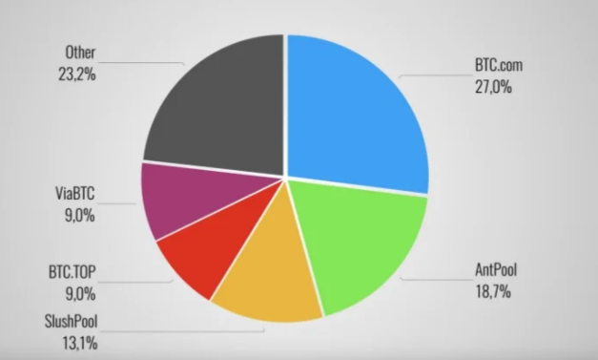
Concern

Slide 28
Proof of Stake

Slide 29
Proof of Stake
Originated in 2011 by Quantum Mechanic (bitcointalk.org)
It was created with a thought that letting everyone compete with each other for mining is wasteful(PoW)
Creator of a new block is chosen in a deterministic way, depending on its wealth, also defined as stake.
There is no particular reward for creation for blocks, rather the validators take the transaction fees.

Slide 30
How it works?
Transactions are bundled together into what we call a block
Validators will stake(personal wealth as security deposit) to be randomly selected in a deterministic way
Validators will mint/forge a new block.
Validators take the transaction fees inside a block. They lose a part of stake if they verify fraud transactions.
Verified transactions are stored in the blockchain

Slide 31
Block Selection Variants
Cryptocurrencies using Proof of Stake often start by selling pre-mined coins or they launch with the Proof of Work algorithm and later switch over to Proof of Stake.
Where in Proof of Work-based systems more and more cryptocurrency is created as rewards for miners, the Proof-of-Stake system usually uses transaction fees as a reward.

Slide 32
Block Selection Variants
Users who want to participate in the forging process, are required to lock a certain amount of coins into the network as their stake.
The size of the stake determines the chances for a node to be selected as the next validator to forge the next block - the bigger the stake, the bigger the chances.
In order for the process not to favor only the wealthiest nodes in the network, more unique methods are added into the selection process.
The two most commonly used methods are ‘Randomized Block Selection’ and ‘Coin Age Selection’.

Slide 33
Block Selection Variants
In the Randomized Block Selection method the validators are selected by looking for nodes with a combination of the lowest hash value and the highest stake and since the size of stakes are public, the next forger can usually be predicted by other nodes.

Slide 34
Block Selection Variants
The Coin Age Selection method chooses nodes based on how long their tokens have been staked for.
Coin age is calculated by multiplying the number of days the coins have been held as stake by the number of coins that are staked.
Once a node has forged a block, their coin age is reset to zero and they must wait a certain period of time to be able to forge another block - this prevents large stake nodes from dominating the blockchain.

Slide 35
Additional Points
Stake vs Chance relation is linear : In PoW, the price of mining equipment reduce with high quantity, where as here it’s always linear. In this way, its more efficient
Validators lose a portion of stake if they verify fraudulent transaction: As long as the stake is higher from the transaction fees, we can trust that validators to correctly do their job.
If node stop being a validator: Validator stake plus transaction fees will be released after a certain period of time.

Slide 36
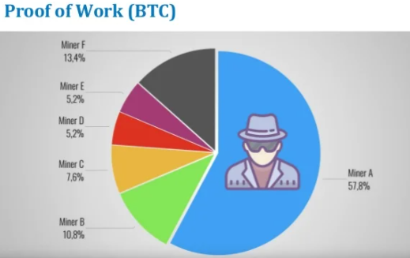
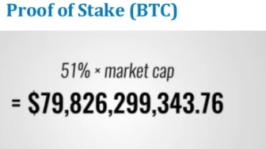
The 51% Attack

Slide 37
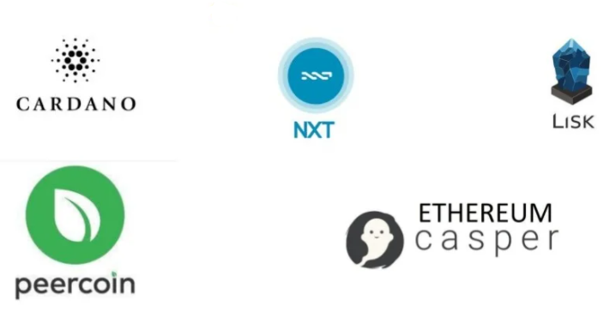
Who uses it

Slide 38
Proof of Burn

Slide 39
Proof of Burn
Proof of burn (POB) is an alternative consensus algorithm that tries to address the high energy consumption issue of a POW system.
POB is often called a POW system without energy waste. It operates on the principle of allowing miners to “burn” virtual currency tokens.
They are then granted the right to write blocks in proportion to the coins burnt.

Slide 40
Cont.
Iain Stewart, the inventor of the POB algorithm, uses an analogy to describe the algorithm: burnt coins are like mining rigs.
In this analogy, a miner burns their coins to buy a virtual mining rig that gives them the power to mine blocks.
The more coins burned by the miner, the bigger their virtual mining "rig" will be.

Slide 41
Cont.
To burn the coins, miners send them to a verifiably un-spendable address.
This process does not consume many resources (other than the burned coins) and ensures that the network remains active and agile.
Depending upon the implementation, miners are allowed to burn the native currency or the currency of an alternate chain, such as Bitcoin.
In exchange, they receive a reward in the native currency token of the blockchain.

Slide 42
Cont.
You can send out transactions to the network that will burn your own cryptocurrency coins.
Other participants can mine/burn on top of your block, and you can also take the transactions of other participants to add them to your block.
Essentially, all of this burning activity keeps the network agile, and participants are rewarded for their activities (both burning their own coins and burning other people’s coins).

Slide 43
Cont.
To prevent the possibility of unfair advantages for early adopters, the POB system has implemented a mechanism that promotes the periodic burning of cryptocurrency coins to maintain mining power.
The power of burnt coins “decays” or reduces partially each time a new block is mined.
This promotes regular activity by the miners, instead of a one-time, early investment.
To maintain a competitive edge, miners may also need to periodically invest in better equipment as technology advances.

Slide 44
Examples of PoB
POB implementation can be customized.
For example, Slimcoin, a virtual currency network that uses POB, allows a miner to burn coins that not only gives them the right to compete for the next block but also gives them the chance to receive blocks during a longer time period, for at least a year.

Slide 45
Examples of PoB
Essentially, Slimcoin’s POB implementation combines three algorithms: POW, POS, and the core POB concept.
The process of burning coins utilizes POW; the more coins one burns the more chances one has to mine, thus ensuring POS; and the whole ecosystem follows the POB concept.

Slide 46
Proof of Space

Slide 47
Proof of Space
Proof of space (PoS) is a type of consensus algorithm achieved by demonstrating one's legitimate interest in a service by allocating a non-trivial amount of memory or disk space to solve a challenge presented by the service provider.
The concept was formulated in 2013 by Dziembowski et al.

Slide 48
Cont
Proofs of space are very similar to proofs of work (PoW), except that instead of computation, storage is used to earn cryptocurrency.
Proof-of-space is different from memory-hard functions in that the bottleneck is not in the number of memory access events, but in the amount of memory required.

Slide 49
Proof of Elapsed Time

Slide 50
Proof of Elapsed Time
Proof of elapsed time (PoET) is a blockchain network consensus mechanism that prevents high resource utilization and energy consumption; it keeps the process more efficient by following a fair lottery system.

Slide 51
Cont
The algorithm uses a randomly generated elapsed time to decide mining rights and block winners on a blockchain network.
By running a trusted code within a secure environment, the PoET algorithm also enhances transparency by ensuring lottery results are verifiable by external participants.

Slide 52
Cont
Proof of elapsed time (PoET) is a consensus algorithm developed by Intel Corporation that enables permissioned blockchain networks to determine who creates the next block.
PoET follows a lottery system that spreads the chances of winning equally across network participants, giving every node the same chance.

Slide 53
Cont
The PoET algorithm generates a random wait time for each node in the blockchain network; each node must sleep for that duration.
The node with the shortest wait time will wake up first and win the block, thus being allowed to commit a new block to the blockchain.
The PoET workflow is similar to Bitcoin's proof of work (PoW) but consumes less power because it allows a node to sleep and switch to other tasks for the specified time, thereby increasing network energy efficiency.

Slide 54
How does it work?
Based on the principle of a fair lottery system where every node is equally likely to be chosen, the PoET mechanism spreads the chances of winning across the largest possible number of network participants.
Under PoET, each participating node in the network must wait for a randomly chosen period; the first to complete the designated waiting time wins the new block. Each node in the blockchain network generates a random wait time and sleeps for that specified duration.

Slide 55
Cont
The one to wake up first—that is, the one with the shortest wait time—wakes up and commits a new block to the blockchain, broadcasting the necessary information to the whole peer network. The same process then repeats for the discovery of the next block.

Slide 56
How Is PoET Different from PoW?
Essentially, the workflow is similar to the consensus mechanism followed by Bitcoin's proof of work (PoW) algorithm, but without its high power consumption. It allows a node to sleep and switch to other tasks for the specified time, thereby increasing the network's efficiency.

Slide 57
Cont.
The mechanism of running trusted code within a secure environment also takes care of many other network necessities. It ensures that the trusted code runs within the secure environment and is not alterable by any participant. It also ensures that the results are verifiable by participants or other permissioned entities, thereby enhancing the transparency of the network consensus.

Slide 58
Cont
PoET controls the cost of the consensus process and keeps it nimble so that it remains proportional to the value derived from the process, an essential requirement for the cryptocurrency economy to continue flourishing.
Proof of elapsed time does not promote decentralization and openness like proof of work does because it requires a certificate to be issued to anyone that wants to join the network.

Slide 59
Hyperledger Sawtooth
Hyperledger Sawtooth is an open source blockchain-as-a-service platform—designed for enterprise uses like supply chain and logistics.
It could even be used for inventory management, accounting, or other business tasks that consume time and are prone to error.
PoET is primarily used in Hyperledger Sawtooth. As of February 2022, there isn't a cryptocurrency that uses PoET.

Slide 60
RAFT

Slide 61
RAFT
Raft protocol was developed by Diego Ongaro and John Ousterhout (Stanford University) which won Diego his Ph.D in 2014.
Raft was designed for better understandability of how Consensus can be achieved considering that its predecessor, the Paxos Algorithm, developed by Lesli Lamport is very difficult to understand and implement.
Hence, the title of the paper by Diego, ‘In Search of an Understandable Consensus Algorithm’.
Before Raft, Paxos was considered the holy grail in achieving Consensus.

Slide 62
Paxos Algorithm
Paxos is a family of consensus protocols, that ensure replica consistency in a distributed system of unreliable processors.
The Paxos protocol was introduced in 1989 by Leslie Lamport, named after a fictional legislative consensus system used on the Paxos island in Greece.

Slide 63
Objective of Paxos
To maintain the same ordering of commands among multiple replicas so that all the replicas eventually converge to the same value.
This is similar to the case where multiple cars following the same directions arrive at the same final destination.

Slide 64
Cont
Imagine a wedding happening between n people instead of 2. The priest asks the ‘Do you …’ question to each one of the n people being wed and only if each and every person replies ‘I do’, the wedding is complete.
Replica consensus in Paxos is achieved through a similar mechanism.

Slide 65
Cont
When a client executes a command on a given replica, the replica nominates itself as a leader.
This execution is tagged with the highest number that this replica has seen. Consensus is achieved among replicas through a 2 phase commit protocol.

Slide 66
Cont
Prepare phase: This replica (Proposer) now sends a message to majority of replicas (possibly including itself), about the change and its associated number. If a replica hasn’t previously seen a change with a higher number than the proposal number, it accepts the change.
Commit phase: If all the replicas accept the message, then the proposer sends an accept request to all the replicas and the change is then asynchronously propagated to all of them.

Slide 67
Livelock Problem
If the rate of incoming requests from different replicas is higher than the acceptance rate, each request will be rejected by a newer request with a higher number, resulting in no request being committed even if the system is up and running. This situation is called Livelock.

Slide 68
RAFT Consensus
Raft states that each node in a replicated state machine(server cluster) can stay in any of the three states, namely, leader, candidate, follower.
Under normal conditions, a node can stay in any one of the above three states.
Only a leader can interact with the client; any request to the follower node is redirected to the leader node.
A candidate can ask for votes to become the leader. A follower only responds to candidate(s) or the leader.

Slide 69
Term Number
This term number is maintained by every node and is passed while communications between nodes.
Every term starts with an election to determine the new leader. The candidates ask for votes from other server nodes(followers) to gather majority.
If the majority is gathered, the candidate becomes the leader for the current term.
If no majority is established, the situation is called a split vote and the term ends with no leader. Hence, a term can have at most one leader.

Slide 70
Purpose of maintaining term number
Servers update their term number if their term number is less than the term numbers of other servers in the cluster.
This means that when a new term starts, the term numbers are tallied with the leader or the candidate and are updated to match with the latest one(Leader’s)

Slide 71
Purpose of maintaining term number
Candidate or Leader demotes to the Follower state if their term number is out of date(less than others).
If at any point of time, any other server has a higher term number, it can become the Leader immediately.

Slide 72
Purpose of maintaining term number
As we said earlier that the term number of the servers are also communicated, if a request is achieved with a stale term number, the said request is rejected.
This basically means that a server node will not accept requests from server with lower term number.

Slide 73
RAFT Algorithm RPCs
RequestVotes RPC is sent by the Candidate nodes to gather votes during an election
AppendEntries is used by the Leader node for replicating the log entries and also as a heartbeat mechanism to check if a server is still up. If heartbeat is responded back to, the server is up else, the server is down. Be noted that the heartbeats do not contain any log entries.

Slide 74
Leader Election in RAFT
In order to maintain authority as a Leader of the cluster, the Leader node sends heartbeat to express dominion to other Follower nodes.
A leader election takes place when a Follower node times out while waiting for a heartbeat from the Leader node.
At this point of time, the timed out node changes it state to Candidate state, votes for itself and issues RequestVotes RPC to establish majority and attempt to become the Leader.

Slide 75
Leader Election in RAFT
The election can go the following three ways:
The Candidate node becomes the Leader by receiving the majority of votes from the cluster nodes. At this point of time, it updates its status to Leader and starts sending heartbeats to notify other servers of the new Leader.
The Candidate node fails to receive the majority of votes in the election and hence the term ends with no Leader. The Candidate node returns to the Follower state.

Slide 76
Leader Election in RAFT
The election can go the following three ways:
If the term number of the Candidate node requesting the votes is less than other Candidate nodes in the cluster, the AppendEntries RPC is rejected and other nodes retain their Candidate status. If the term number is greater, the Candidate node is elected as the new Leader.

Slide 77
Thank You

